Slide 1
Computer Graphics

Slide 2
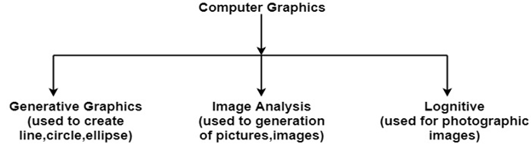
Unit I Graphics Primitives & Scan Conversion Algorithms
Definition of Computer Graphics:
It is the use of computers to create and manipulate pictures on a display device. It comprises of software techniques to create, store, modify, represents pictures.
Why computer graphics used?
Interactive computer graphics work using the concept of two-way communication between computer users. The computer will receive signals from the input device, and the picture is modified accordingly. Picture will be changed quickly when we apply command.

Slide 3
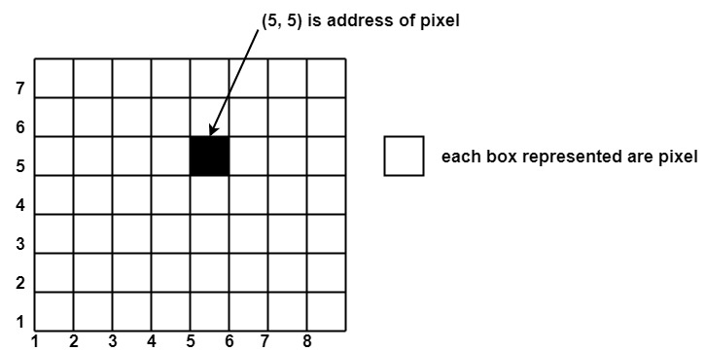
Pixel
The full form of the pixel is "Picture Element." It is also known as "PEL”. Pixel is the smallest element of an image on a computer display, whether they are LCD or CRT monitors.
A screen is made up of a matrix of thousands or millions of pixels. A pixel is represented with a dot or a square on a computer screen.
Each pixel has a value, or we can say a unique logical address. It can have only one color at a time.
Colour of a pixel is determined by the number of bits which is used to represent it. A resolution of a computer screen depends upon graphics card and display monitor, the quantity, size and color combination of pixels

Slide 4

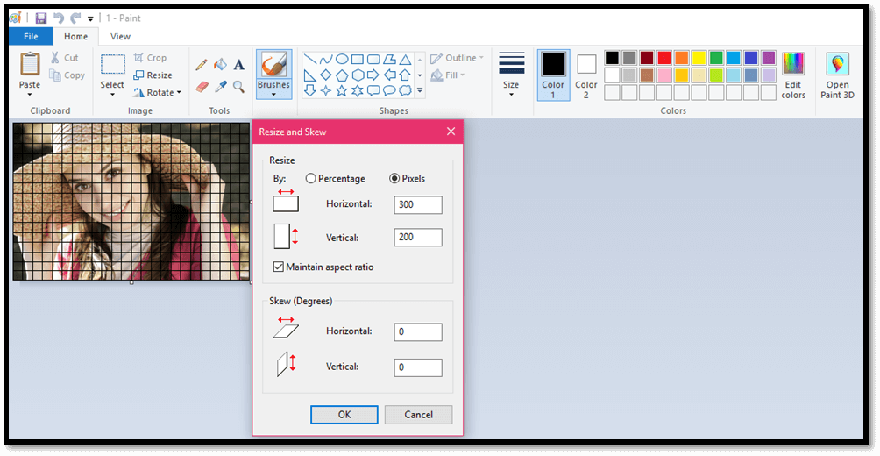
When an image has zoomed in, the surface of CCD will look like filled dots.
These dots are light receptor called photodiode.
Calculation of the total number of pixels
Below is the formula to calculate the total number of pixel in an image.

Slide 5
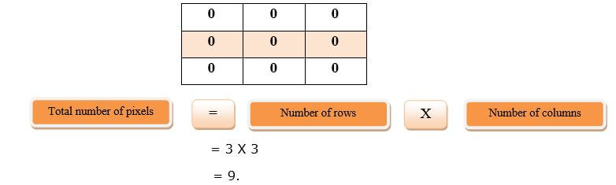
Pixel value(0)
As we know that each pixel has a unique value. 0 is a unique value that means the absence of light. It means that 0 is used to denote dark.
For example:
We have a matrix of 3X3 of an image, and each pixel is of value as shown below:
It means the image formed is of 9 pixels which are black.

Slide 6
Resolution
The resolution can be defined in many ways. Such as pixel resolution, spatial resolution, temporal resolution, spectral resolution. Out of which we are going to discuss pixel resolution.
You have probably seen that in your own computer settings, you have monitor resolution of 800 x 600, 640 x 480 etc
In pixel resolution, the term resolution refers to the total number of count of pixels in an digital image. For example. If an image has M rows and N columns, then its resolution can be defined as M X N.
If we define resolution as the total number of pixels, then pixel resolution can be defined with set of two numbers. The first number the width of the picture, or the pixels across columns, and the second number is height of the picture, or the pixels across its width.

Slide 7
Aspect ratio
Another important concept with the pixel resolution is aspect ratio.
Aspect ratio is the ratio between width of an image and the height of an image. It is commonly explained as two numbers separated by a colon (8:9). This ratio differs in different images, and in different screens.
The common aspect ratios are:
1.33:1, 1.37:1, 1.43:1, 1.50:1, 1.56:1, 1.66:1, 1.75:1, 1.78:1, 1.85:1, 2.00:1, e.t.c
Advantage
Aspect ratio maintains a balance between the appearance of an image on the screen, means it maintains a ratio between horizontal and vertical pixels. It does not let the image to get distorted when aspect ratio is increased.

Slide 8
We can say that the higher is the pixel resolution, the higher is
the quality of the image.
Megapixels
We can calculate mega pixels of a camera using pixel resolution.
Column pixels (width ) X row pixels ( height ) / 1 Million.
The size of an image can be defined by its pixel resolution.
Size = pixel resolution X bpp ( bits per pixel )
Calculating the mega pixels of the camera
Lets say we have an image of dimension: 2500 X 3192.
Its pixel resolution = 2500 * 3192 = 7982350 bytes.
Dividing it by 1 million = 7.9 = 8 mega pixel (approximately).

Slide 9
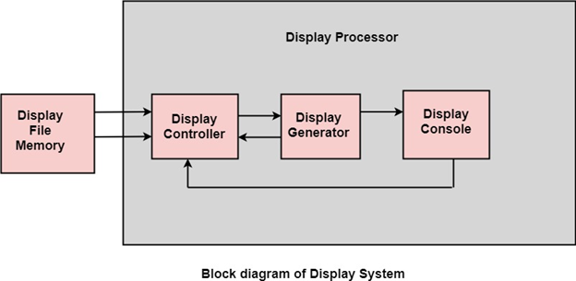
Display devices :
Display Processor:
It is interpreter or piece of hardware that converts display processor code into pictures. There are four main parts of the display processor.
Parts of Display Processor
1)Display File Memory
2) Display Controller
3) Display Generator
4)Display Console

Slide 10
Display File Memory:
It is used for generation of the picture. It is used for identification of graphic entities.
Display Controller:
* It handles interrupt
* It maintains timings
* It is used for interpretation of instruction.
Display Generator:
* It is used for the generation of character.
* It is used for the generation of curves.
Display Console:
It contains CRT, Light Pen, and Keyboard and deflection system.
The raster scan system is a combination of some processing units. It consists of the control processing unit (CPU) and a particular processor called a display controller. Display Controller controls the operation of the display device. It is also called a video controller.

Slide 11
Display Devices:
The most commonly used display device is a video monitor. The operation of most video monitors based on CRT (Cathode Ray Tube).
The following display devices are used:
1) Cathode Ray Tube
2) Random Scan and Raster Scan
3) Color CRT Monitors
4) Direct View Storage Tubes
5) Flat Panel Display
1)CRT
CRT stands for Cathode Ray Tube. CRT is a technology used in traditional computer monitors and televisions. The image on CRT display is created by firing electrons from the back of the tube of phosphorus located towards the front of the screen.

Slide 12
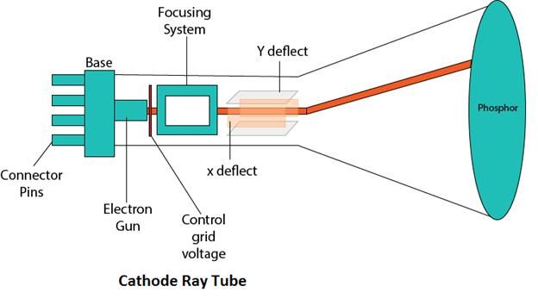
Components of CRT:
1. Electron Gun: Electron gun consisting of a series of elements, primarily a heating filament (heater) and a cathode. The electron gun creates a source of electrons which are focused into a narrow beam directed at the face of the CRT.
2. Control Electrode: It is used to turn the electron beam on and off.
3. Focusing system: It is used to create a clear picture by focusing the electrons into a narrow beam.
4. Deflection Yoke: It is used to control the direction of the electron beam. It creates an electric or magnetic field which will bend the electron beam as it passes through the area. In a conventional CRT, the yoke is linked to a sweep or scan generator. The deflection yoke which is connected to the sweep generator creates a fluctuating electric or magnetic potential.

Slide 13
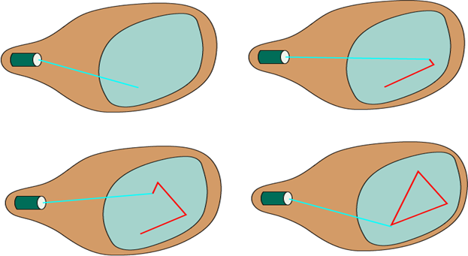
https://youtu.be/zj91VO7WJgU
https://www.youtube.com/watch?v=ijJCTeHcrkU
Random Scan and Raster Scan Display:
Random Scan Display:
Random Scan System uses an electron beam which operates like a pencil to create a line image on the CRT screen. The picture is constructed out of a sequence of straight-line segments. Each line segment is drawn on the screen by directing the beam to move from one point on the screen to the next, where its x & y coordinates define each point. After drawing the picture.
The system cycles back to the first line and design
all the lines of the image 30 to 60 time each second. The process is shown in fig:
Advantages:
* A CRT has the electron beam directed only to
the parts of the screen where an image is to be
drawn.
* Produce smooth line drawings.
* High Resolution

Slide 14
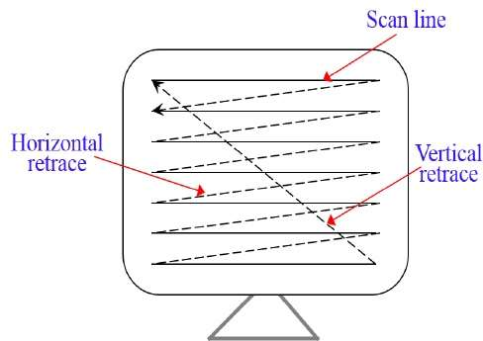
Raster Scan
In a raster scan system, the electron beam is swept across the screen, one row at a time from top to bottom. As the electron beam moves across each row, the beam intensity is turned on and off to create a pattern of illuminated spots.
Picture definition is stored in memory area called the Refresh Buffer or Frame Buffer. This memory area holds the set of intensity values for all the screen points. Stored intensity values are then retrieved from the refresh buffer and “painted” on the screen one row scan line at a time.
Frame Buffer is also known as Raster or bit map. In Frame Buffer the positions are called picture elements or pixels. Beam refreshing is of two types. First is horizontal retracing and second is vertical retracing. When the beam starts from the top left corner and reaches the bottom right scale, it will again return to the top left side called at vertical retrace. Then it will again more horizontally from top to bottom call as horizontal retracing shown in fig:
Each screen point is referred to as a pixel .
At the end of each scan line, the electron beam
returns to the left side of the screen to begin
displaying the next scan line.
Advantages:
Realistic image
Million Different colors to be generated
Shadow Scenes are possible.

Slide 15
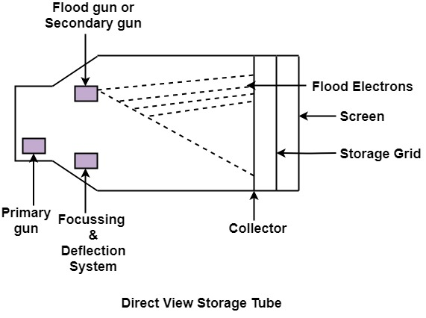
Direct View Storage Tubes:
DVST terminals also use the random scan approach to generate the image on the CRT screen.
The term "storage tube" refers to the ability of the screen to retain the image which has been projected against it, thus avoiding the need to rewrite the image constantly.
Function of guns: Two guns are used in DVST
Primary guns: It is used to store the picture pattern.
Flood gun or Secondary gun: It is used to maintain picture display.
Advantage:
- No refreshing is needed.
- High Resolution
- Cost is very less

Slide 16
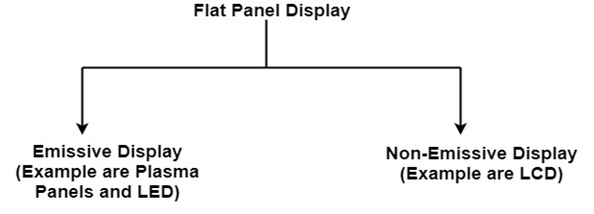
Flat Panel Display:
The Flat-Panel display refers to a class of video devices that have reduced volume, weight and power requirement compare to CRT.
Example: Small T.V. monitor, calculator, pocket video games, laptop computers, an advertisement board in elevator.
1. Emissive Display: The emissive displays are devices that convert electrical energy into light. Examples are Plasma Panel, thin film electroluminescent display and LED (Light Emitting Diodes).
In an LED, a matrix of diodes is organized to form the pixel positions in the display and picture definition is stored in a refresh buffer. Data is read from the refresh buffer and converted to voltage levels that are applied to the diodes to produce the light pattern in the display.

Slide 17
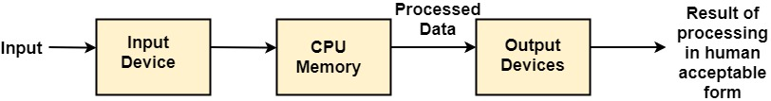
2. Non-Emissive Display: The Non-Emissive displays use optical effects to
convert sunlight or light from some other source into graphics patterns.
Examples are LCD (Liquid Crystal Device).
Liquid Crystal Displays are the devices that produce a picture by passing polarized light from the surroundings or from an internal light source through a liquid-crystal material that transmits the light.
Input Devices
The Input Devices are the hardware that is used to transfer transfers input to the computer. The data can be in the form of text, graphics, sound, and text. Output device display data from the memory of the computer. Output can be text, numeric data, line, polygon, and other objects.

Slide 18
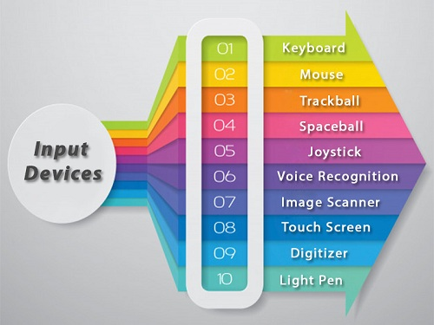
These Devices include:
Keyboard
Mouse
Trackball
Spaceball
Joystick
Light Pen
Digitizer
Touch Panels
Voice Recognition
Image Scanner

Slide 19
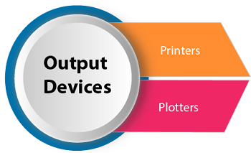
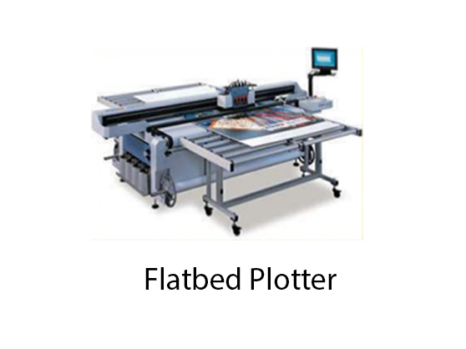
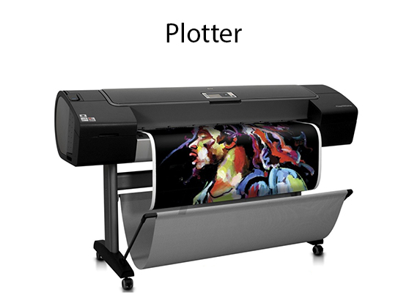
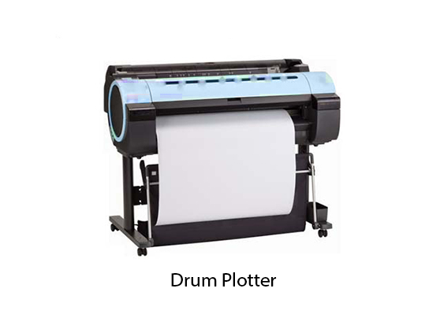
Output Devices
It is an electromechanical device, which accepts data from a computer &
translates them into form understand by users.
Following are Output Devices:
Printers :
Printer is the most important output device, which is used to print data on paper.
Plotters:
Plotters are a special type of output device.
It is suitable for applications:
* Architectural plan of the building.
* CAD applications like the design of mechanical components of aircraft.
* Many engineering applications.

Slide 20
Application of Computer Graphics
Education and Training: Computer-generated model of the physical, financial and economic system is often used as educational aids. Model of physical systems, physiological system, population trends or equipment can help trainees to understand the operation of the system.
Use in Biology: Molecular biologist can display a picture of molecules and gain insight into their structure with the help of computer graphics.
Computer-Generated Maps: Town planners and transportation engineers can use computer-generated maps which display data useful to them in their planning work.
Architect: Architect can explore an alternative solution to design problems at an interactive graphics terminal. In this way, they can test many more solutions that would not be possible without the computer.

Slide 21
Application of Computer Graphics
5. Presentation Graphics: Example of presentation Graphics are bar charts, line graphs, pie charts and other displays showing relationships between multiple parameters. Presentation Graphics is commonly used to summarize Financial Reports, Statistical Reports, Mathematical Reports, Scientific Reports, Economic Data for research reports, Managerial Reports And other types of reports.
6. Computer Art: Computer Graphics are also used in the field of commercial arts. It is used to generate television and advertising commercial.
7. Entertainment: Computer Graphics are now commonly used in making motion pictures, music videos and television shows.
8. Visualization: It is used for visualization of scientists, engineers, medical personnel, business analysts for the study of a large amount of information.
9. Educational Software: Computer Graphics is used in the development of educational software for making computer-aided instruction.
10. Printing Technology: Computer Graphics is used for printing technology and textile design.

Slide 22
Application of Computer Graphics
5. Presentation Graphics: Example of presentation Graphics are bar charts, line graphs, pie charts and other displays showing relationships between multiple parameters. Presentation Graphics is commonly used to summarize Financial Reports, Statistical Reports, Mathematical Reports, Scientific Reports, Economic Data for research reports, Managerial Reports And other types of reports.
6. Computer Art: Computer Graphics are also used in the field of commercial arts. It is used to generate television and advertising commercial.
7. Entertainment: Computer Graphics are now commonly used in making motion pictures, music videos and television shows.
8. Visualization: It is used for visualization of scientists, engineers, medical personnel, business analysts for the study of a large amount of information.
9. Educational Software: Computer Graphics is used in the development of educational software for making computer-aided instruction.
10. Printing Technology: Computer Graphics is used for printing technology and textile design.

Slide 23

.

